Slide 1
Model Building for Deployment
Model Deployment & Change Management
Jeremy Bergmann - Omaha Data Science Academy

Slide 2
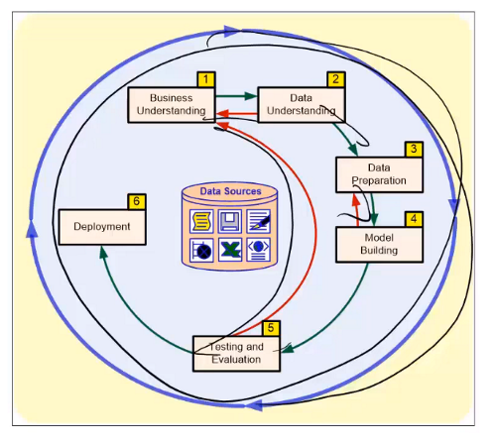
Model Deployment
CRISP-DM Process
Model deployment is the final step of the CRISP-DM process, translating the results of data science projects into business processes/activities.
Often delivered in the form of a “data product” - a product that facilitates an “end goal” through the use of data.
Data Products Include: Automated-Decision Making, Decision Support, Algorithms, derived data and/or raw data collection.
https://towardsdatascience.com/designing-data-products-b6b93edf3d23

Slide 3
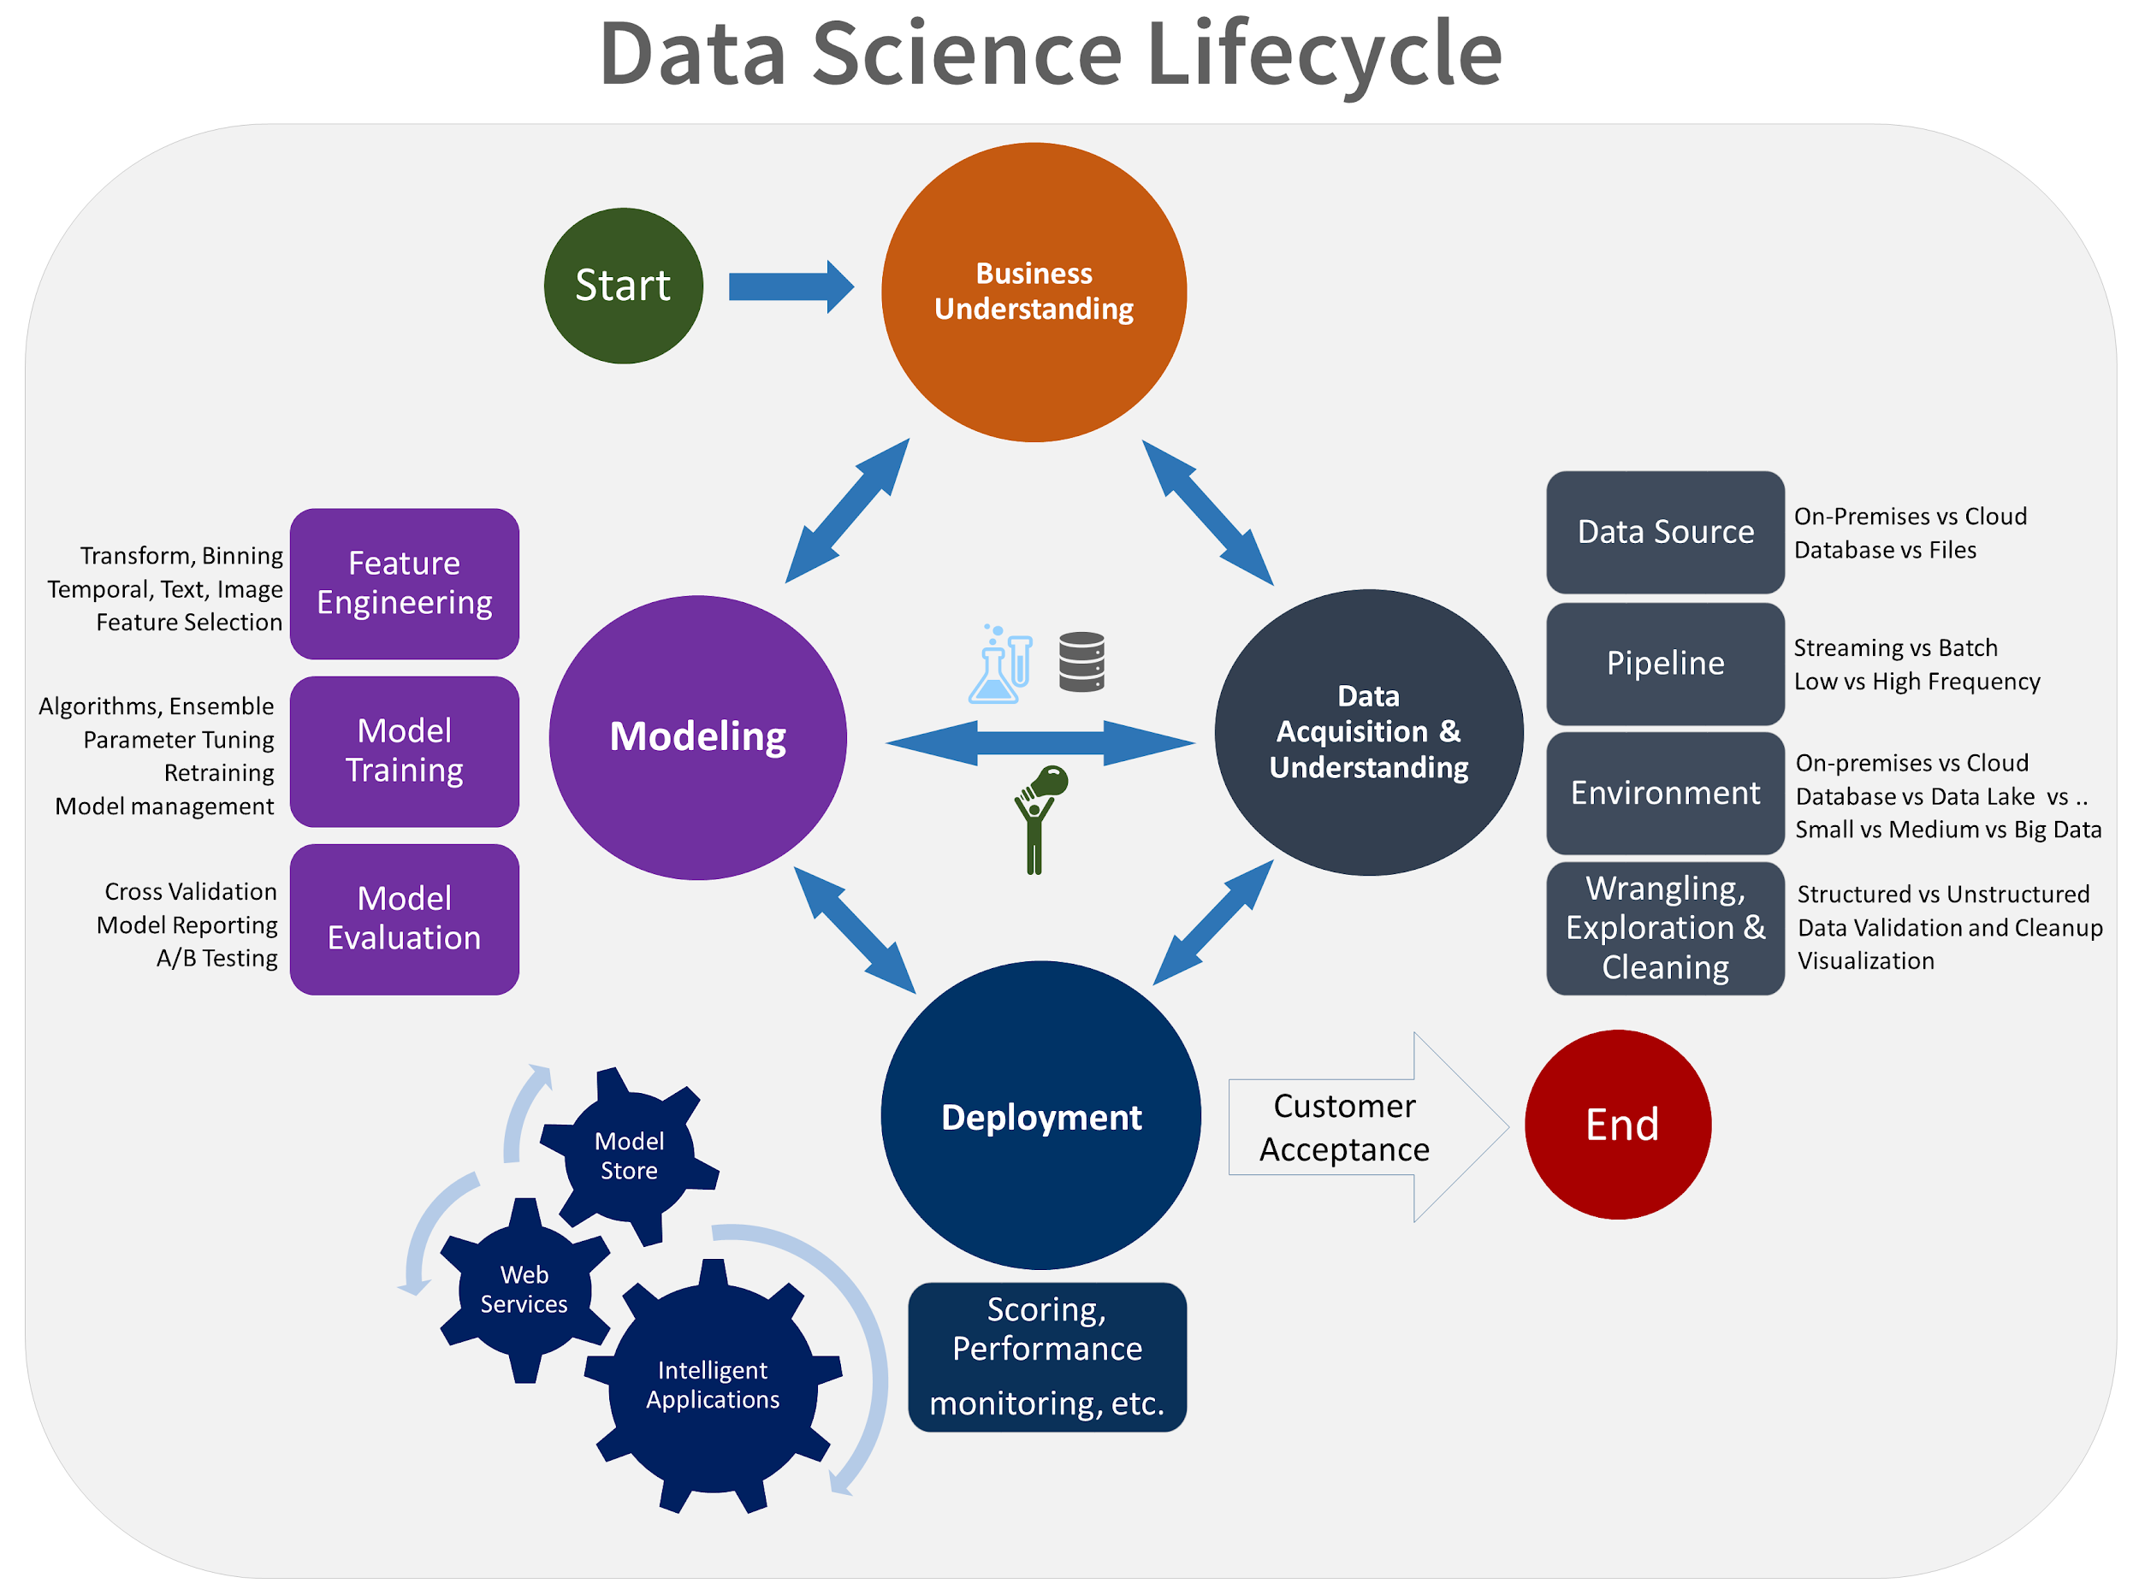
Model Deployment & Beyond
Model Deployment
Create/present report of findings
Planning and development of the deployment procedure(s)
Create Workflow and Deploy data science model
Integration into an organization’s system(s) and/or processes
Development of a monitoring/maintenance plan
Review of the project objective & outcomes
Beyond: Product iteration & “next steps”
Key: CRISP-DM is an iterative approach to Data Science Projects, requiring continual evaluation and improvement after deployment!
Notes:
Good data products are rarely “done”—through usage and continued investigation, you start to understand better the problem that you’re trying to solve. One of the characteristics of working with data is that it’s best to work in an agile way: often you don’t even know the right question to ask until you’ve explored the problem space. Get a product in use early, then learn, adapt, and evolve the product.

Slide 4

Reporting Results
Goal: To present the results of a data science project to the appropriate stakeholders for, in an effective manner.
Final report – this is the final written report of the data mining engagement prepared for management/customers, Including:
Summary of the entire project, reports created up to this point, and its results.
Final presentation – A summary of the final report is presented in a meeting with management. This is also an opportunity to address any open questions.
Notes:
Key difference is in goal - grouping/classification (text mining) vs. meaning & context (NLP)
NLP Introduction: https://blog.algorithmia.com/introduction-natural-language-processing-nlp/

Slide 5
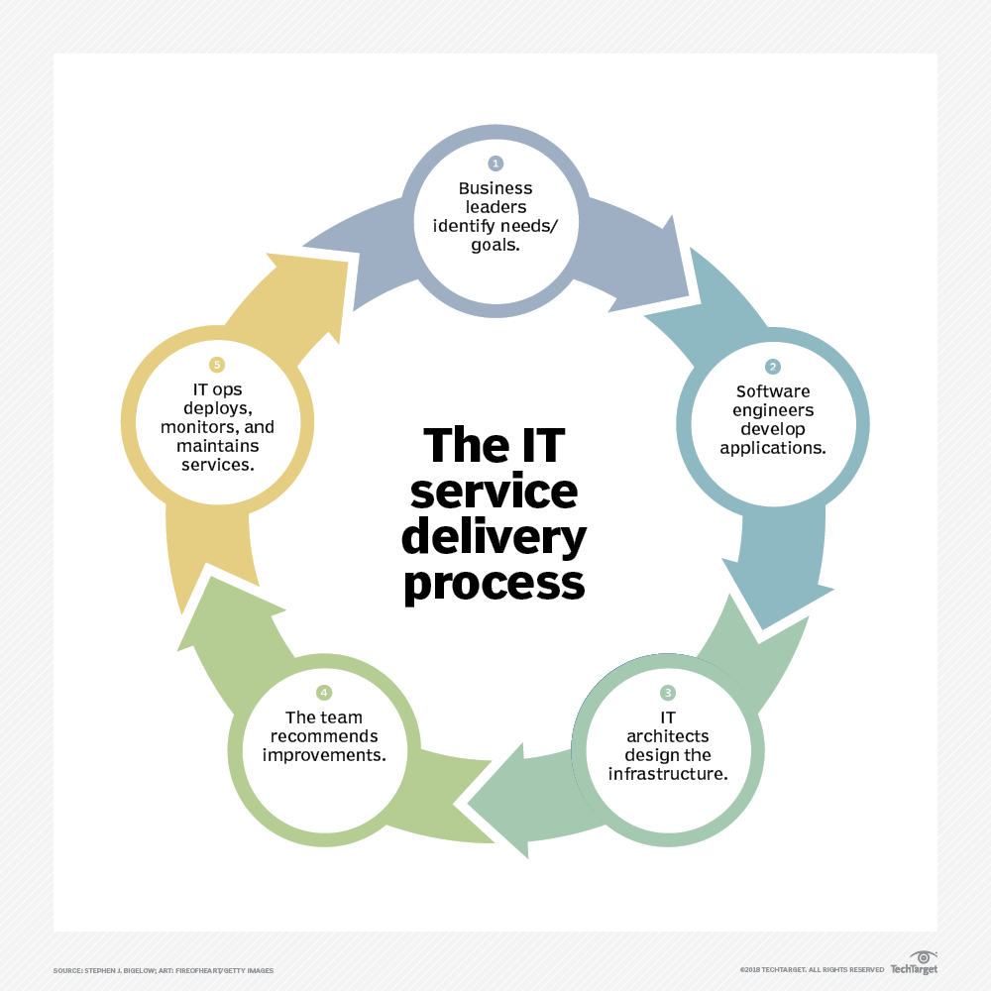
Planning Deployment
Goal: Creating a strategy for deployment, the steps required, and the instructions for carrying out those steps.
The deployment plan should be created during the “business understanding” phase, as a crucial part of the success of the data science project.
During this stage, a general procedure has been identified to create the relevant data science model(s), which is documented for later deployment.
Notes:
Challenges in NLP: speech recognition, natural language understanding, and natural language generation.

Slide 6
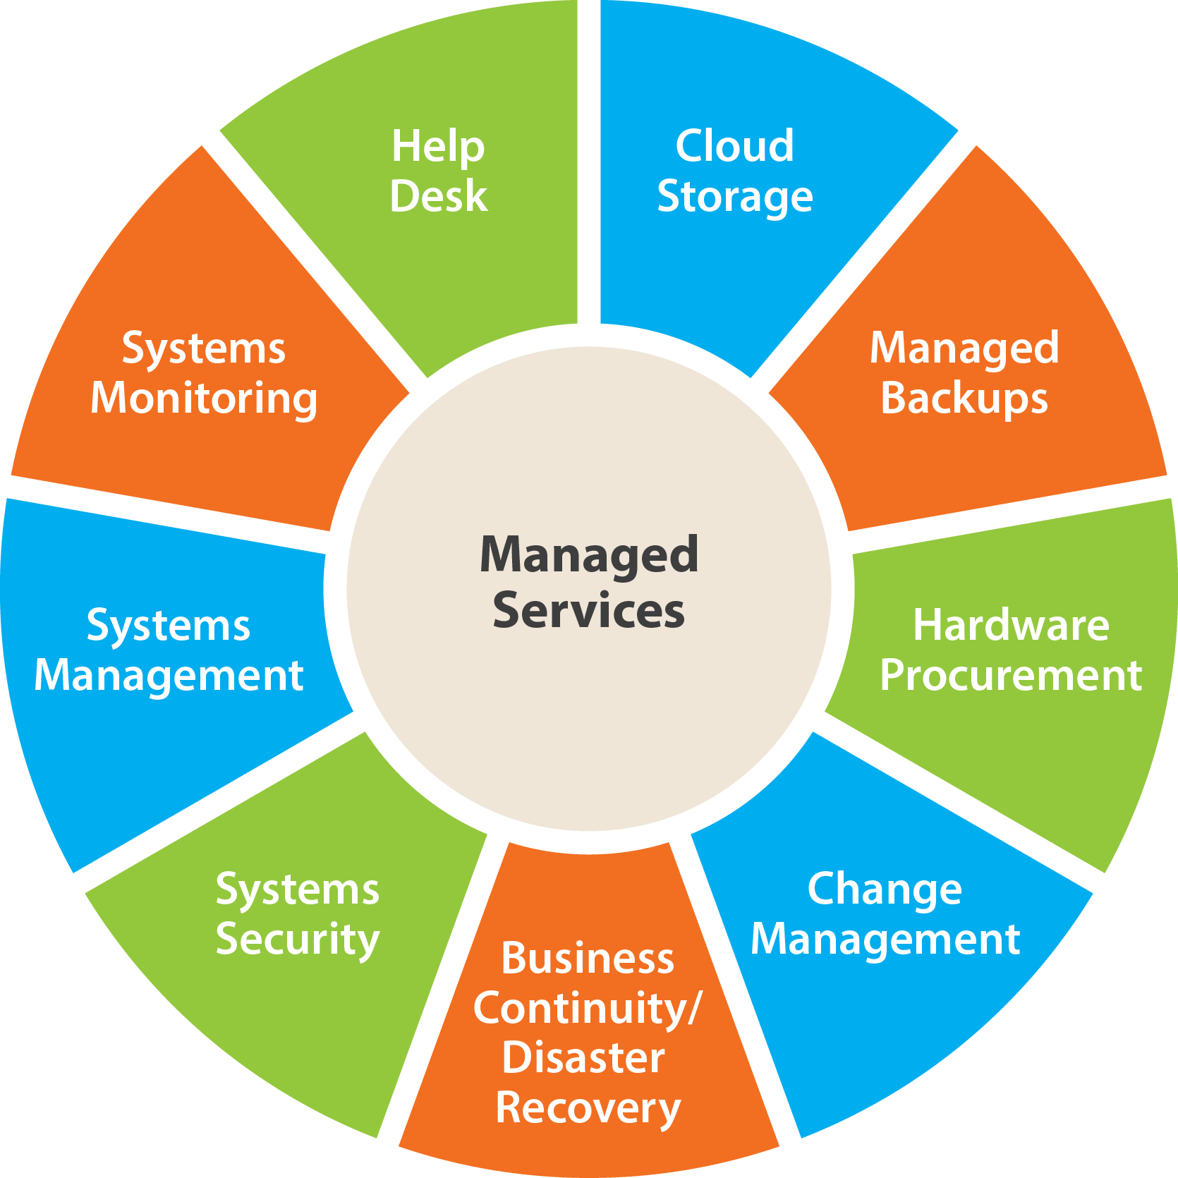
Monitoring & Maintenance
Goal: The process of outlining the monitoring and maintenance strategy of existing data products.
Monitoring and maintenance are important issues if the data mining result becomes part of the day-to-day business and its environment. The careful preparation of a maintenance strategy helps to avoid unnecessarily long periods of incorrect usage of data mining results.
In order to monitor the deployment of the data mining result(s), the project needs a detailed monitoring process plan. This plan takes into account the specific type of deployment and data product.
Source: https://www.sv-europe.com/deployment/

Slide 7
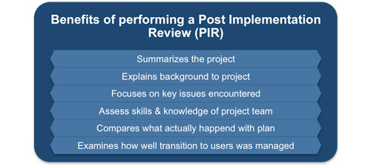
Project Review
Goal: Assess what went right and what went wrong, what was done well and what needs to be improved.
Experience documentation that summarise important experience gained during the project, such as:
Pitfalls & Misleading approaches
Hints for selecting the best suited data mining techniques in similar situations
Improvements to future projects
Notes:
Other word2vec overview links: https://skymind.ai/wiki/word2vec,
Skipgram algorithm: http://mccormickml.com/2016/04/19/word2vec-tutorial-the-skip-gram-model/

Slide 8

Product Iteration & “Next Steps”
Goal: Implement the “Next Steps” of a data science project to ensure the success of a project.
This includes resulting action items, follow-ups and iterating on prescribed improvements.
“Next Steps” include:
Improving existing data products
End-user education & support
Tracking results & follow-up
Notes:
Other word2vec overview links: https://skymind.ai/wiki/word2vec,
Skipgram algorithm: http://mccormickml.com/2016/04/19/word2vec-tutorial-the-skip-gram-model/

Slide 9
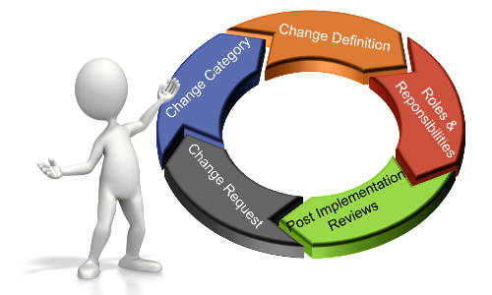
Change Management
The goal change management is to ensure that standardized methods and procedures are used for changes to IT infrastructure, to minimize the number and impact of any related incidents upon service.
A change is an event that is:
Approved by management
Implemented with minimized/accepted risk to existing IT infrastructure
Results in a new status of one or more configuration items (CIs)
Provides increased value to the business (increased revenue, avoided cost, or improved service) from the use of the new or enhanced IT systems.
Notes:
Examples of CIs include individual requirements documents, software, models, and plans.
The configuration-management system oversees the life of the CIs through a combination of processes and tools by implementing and enabling the fundamental elements of identification, change management, status accounting, and audits.
This system aims to avoid the introduction of errors related to lack of testing as well as of incompatibilities with other CIs.

Slide 10

Change Management Using Github
GitHub supports IT Change Management Processes, as follows:
Documentation, including automatically rendered README files and Wikis
Issue tracking (including feature requests) with labels, milestones, assignees and a search engine
Pull requests with code review and comments
Branching & Code commit history
Project Management Graphs: pulse, contributors, commits, code frequency, punch card, network, members
Nested task-lists within files
Security Alerts of known Common Vulnerabilities and Exposures in different packages
The world's leading software development platform
Training Exercises: https://lab.github.com

Slide 11

Creating Workflows using Dataiku
Dataiku supports the creation of data products, and adheres to Change Management Processes, as follows:
Project Management: Manage & track large scale projects from data management
Operationalization: Automate, operationalize, and monitor data pipelines without re-thinking existing infrastructures
Reproducibility: deployed code reproducible and unmaintained projects won’t fail.
Code & Integration: Build end-to-end solutions and services with Dataiku’s transparent SDK or leading GUI.
Scalability: Leverage your existing distributed storage and processing infrastructures.
DSS comes with built-in Git-Based version control system
Dataiku DSS “Bring data analysts, engineers, and scientists together”, “Enables self-service analytics” and “operationalizes machine learning” ts today and build for tomorrow.
Notes:
DSS creates and handles git repositiory automcatically - can have more control over it: Version Control - Dataiku DSS 5.0 Documentation

